Slide 1
Data Structures & Algorithm Analysis
Big-OH, Runtime Analysis

Slide 2
Algorithmic thinking
Big-oh, Runtime Analysis

Slide 3
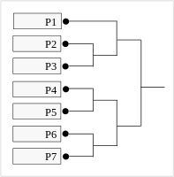
What is the solution?
“If you had 1,513 participants in a tournament, how many games would need to be played to determine the winner”
Assume this is a single-elimination tournament. (i.e. the loser of each match exits the tournament)

Slide 4

Goals
To change the way we think when problem solving
“To think outside the box”
To determine whether a solution is a good solution
Does it solve the problem?
Efficient?
Straightforward?
Elegant?

Slide 5


Group problems
“A peasant finds himself on a riverbank with a wolf, a goat and a head of cabbage. He needs to transport all three to the other side of the river in his boat. However, the boat has room for only the peasant himself and one other item (either the wolf, the goat, or the cabbage). In his absence, the wolf would eat the goat, and the goat would eat the cabbage. Solve this problem for the peasant or prove it has no solution.”
“There are four people who want to cross a bridge; they all begin on the same side. You have 17 minutes to get them all across to the other side. It is night, and they have on flashlight. A maximum of two people can cross the bridge at one time. Any party that crosses, either one or two people, must have the flashlight with them. The flashlight must be walked back and forth; it cannot be thrown, for example. Person 1 takes 1 minute to cross the bridge, person 2 takes 2 minutes, person 3 takes 5 minutes and person 4 takes 10 minutes. A pair must walk together at the rate of the slower person’s pace. For example, if person 1 and person 4 walk across first, 10 minutes have elapsed when they get to the other side of the bridge. If person 4 returns the flashlight, a total of 20 minutes have passed and you have failed the mission.”

Slide 6
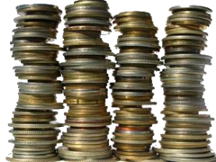

Group problems
“There are 100 coins divided into 10 stacks, with 10 coins in each
stack. 90 of these coins are genuine and 10 are fake. All 10 fake coins are located in a single stack. Assume that a genuine coin weighs 10 ounces and a fake coin weighs 9 ounces.
Given a scale with which you can weigh any number of coins, and using
only one weighing, describe how you would determine which stack
contains the fake coins.”
“An executioner lines up 100 prisoners single file and puts a red or a blue hat on each prisoner's head. Every prisoner can see the hats of the people in front of him in the line - but not his own hat, nor those of anyone behind him. The executioner starts at the end (back) and asks the last prisoner the color of his hat. He must answer "red" or "blue." If he answers correctly, he is allowed to live. If he gives the wrong answer, he is killed instantly and silently. (While everyone hears the answer, no one knows whether an answer was right.) On the night before the line-up, the prisoners confer on strategy to help them. Find a strategy where the fewest number of prisoners die.”
Note: You can solve this problem with at most one individual dying.
Challenge Problem

Slide 7
Math Review
Big-oh, Runtime Analysis

Slide 8
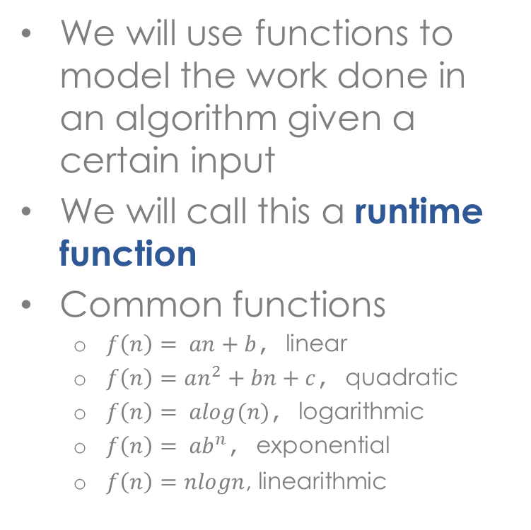
Importance of mathematical functions
We will use functions to model the work done in an algorithm given a certain input
We will call this a runtime function
Common functions
$f\left(n\right)= an+b$, linear
$f\left(n\right)=an^{2}+bn+c$, quadratic
$f\left(n\right)= alog(n)$, logarithmic
${f\left(n\right)= ab}^{n}$, exponential
$f\left(n\right)=nlogn$, linearithmic
f(n) = 2n + 1
work
input size
Note: a, b & c are constants

Slide 9
Functions of interest
linear
quadratic
exponential
constant
log
linearithmic

Slide 10
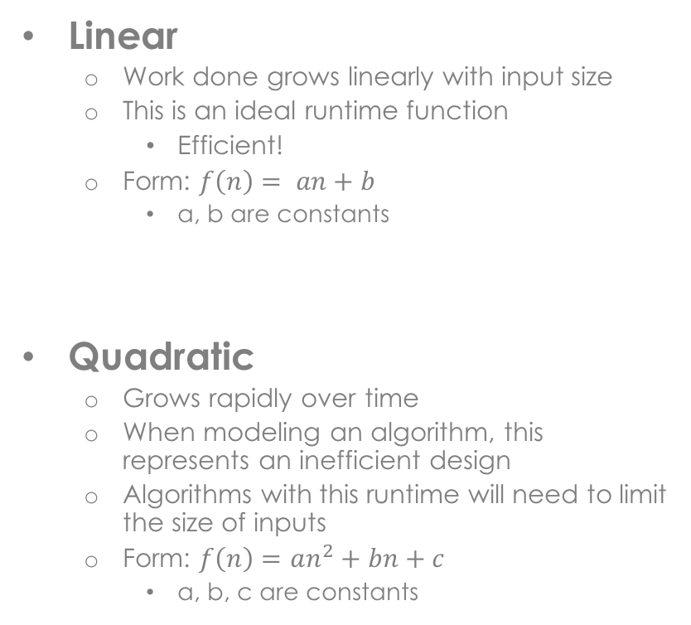
Linear, Quadratic functions
Linear
Work done grows linearly with input size
This is an ideal runtime function
Efficient!
Form: $f\left(n\right)= an+b$
a, b are constants
Quadratic
Grows rapidly over time
When modeling an algorithm, this represents an inefficient design
Algorithms with this runtime will need to limit the size of inputs
Form: $f\left(n\right)=an^{2}+bn+c$
a, b, c are constants
linear
quadratic

Slide 11
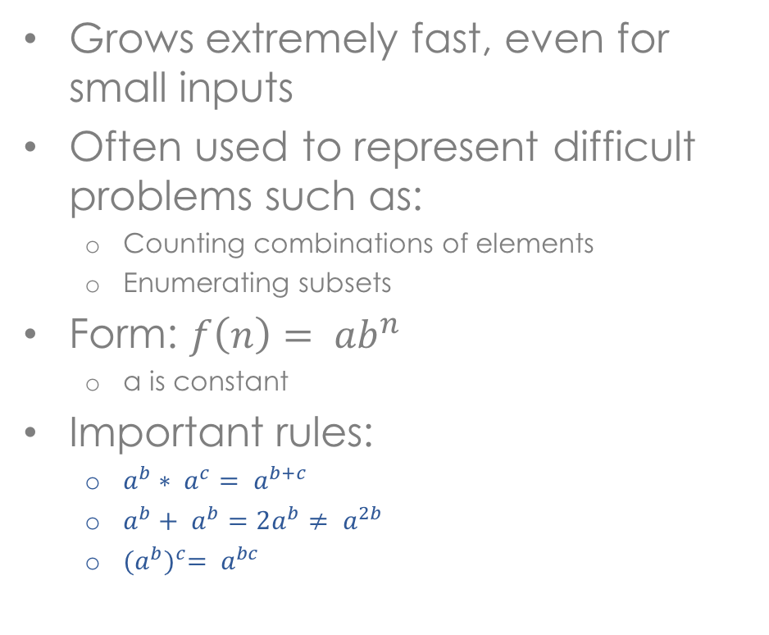
Exponential functions
Grows extremely fast, even for small inputs
Often used to represent difficult problems such as:
Counting combinations of elements
Enumerating subsets
Form: ${f\left(n\right)= ab}^{n}$
a is constant
Important rules:
$a^{b}∗ a^{c}= a^{b+c}$
$a^{b}+ a^{b}=2a^{b}≠ a^{2b}$
${(a^{b})}^{c}= a^{bc}$
exponential

Slide 12

Constant functions
Represents the most ideal of situations
The work performed in an algorithm is constant
ie. unchanging with larger input sizes
Very few algorithms of interest exhibit this behavior
constant

Slide 13
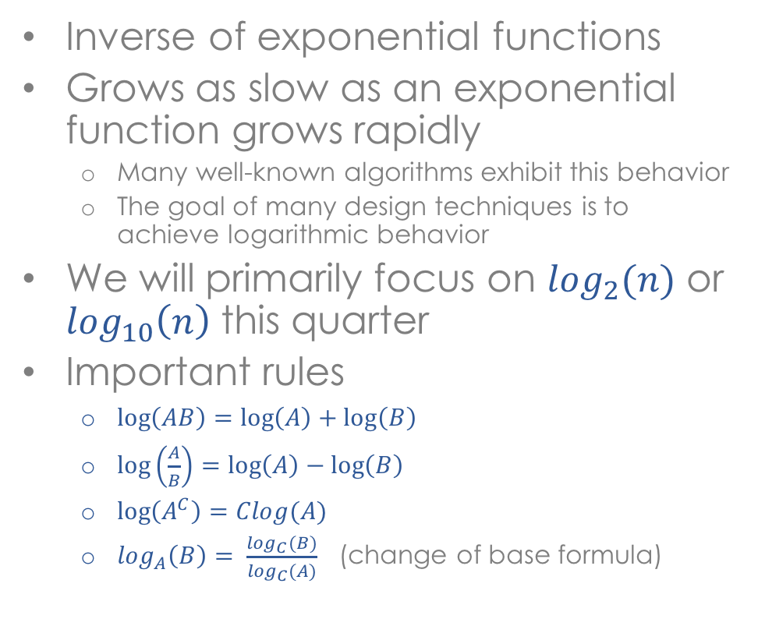
Log functions
Inverse of exponential functions
Grows as slow as an exponential function grows rapidly
Many well-known algorithms exhibit this behavior
The goal of many design techniques is to achieve logarithmic behavior
We will primarily focus on $\log_{2}(n)$ or $\log_{10}\left(n\right)$ this quarter
Important rules
$\log\left(AB\right)=\log\left(A\right)+\log\left(B\right)$
$\log\left(\frac{A}{B}\right)=\log\left(A\right)−\log\left(B\right)$
$\log\left(A^{C}\right)=Clog(A)$
$\log_{A}\left(B\right)= \frac{\log_{C}(B)}{\log_{C}(A)}$ (change of base formula)
log

Slide 14
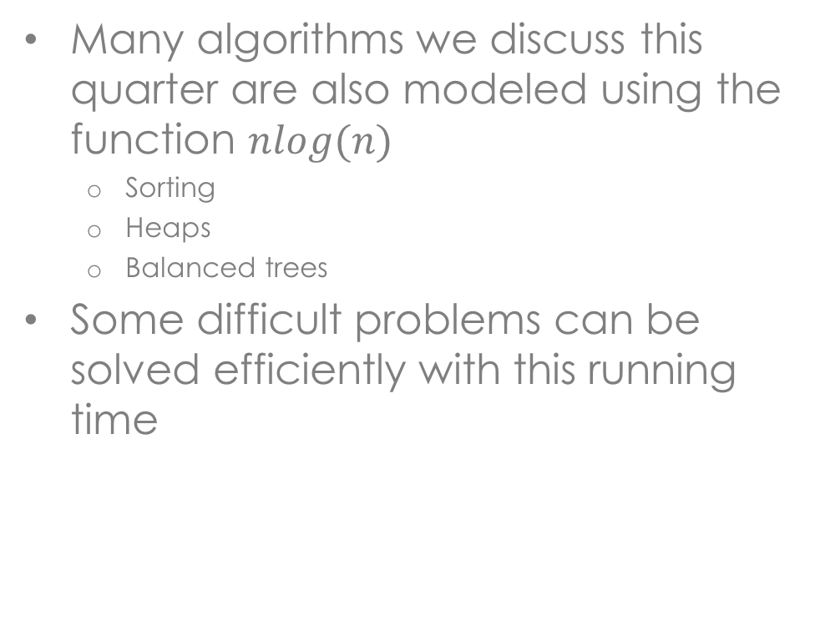
Linearithmic functions
Many algorithms we discuss this quarter are also modeled using the function $nlog(n)$
Sorting
Heaps
Balanced trees
Some difficult problems can be solved efficiently with this running time
linearithmic

Slide 15
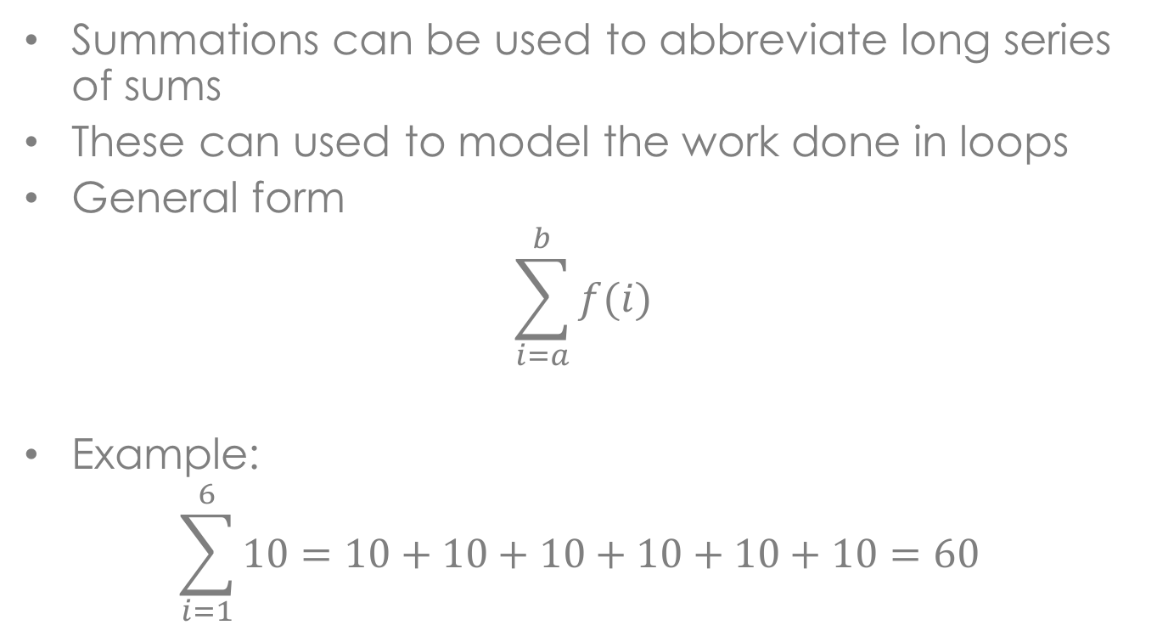
Summations and their role in analysis
Summations can be used to abbreviate long series of sums
These can used to model the work done in loops
General form
$$\sum_{i=a}^{b}{f(i)}$$
Example:
$$\sum_{i=1}^{6}{10=10+10+10+10+10+10=60 }$$
six terms

Slide 16
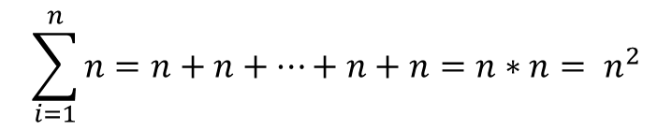
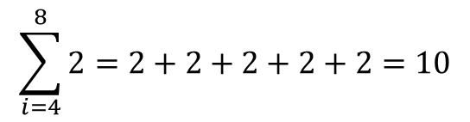
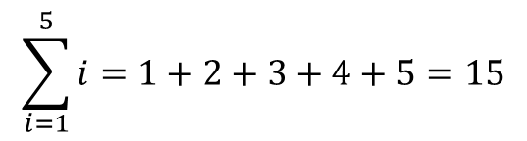
Summations
Other examples
Uses
indexer
i
$$\sum_{i=1}^{5}{i}=1+2+3+4+5=15$$
$$\sum_{i=1}^{n}{n}=n+n+…+n+n=n∗n= n^{2}$$
n terms
$$\sum_{i=4}^{8}{2}=2+2+2+2+2=10$$
8 – 4 + 1 terms

Slide 17
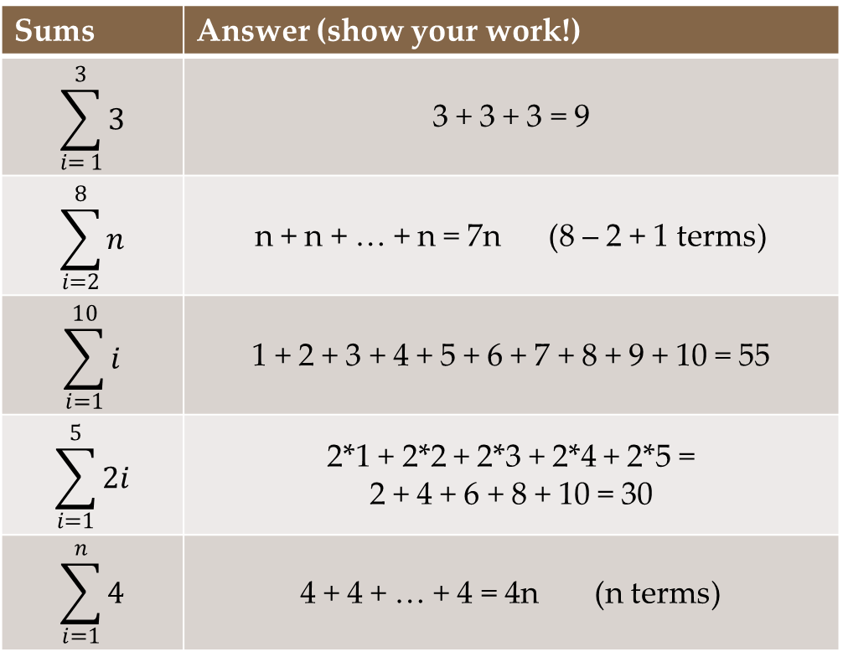
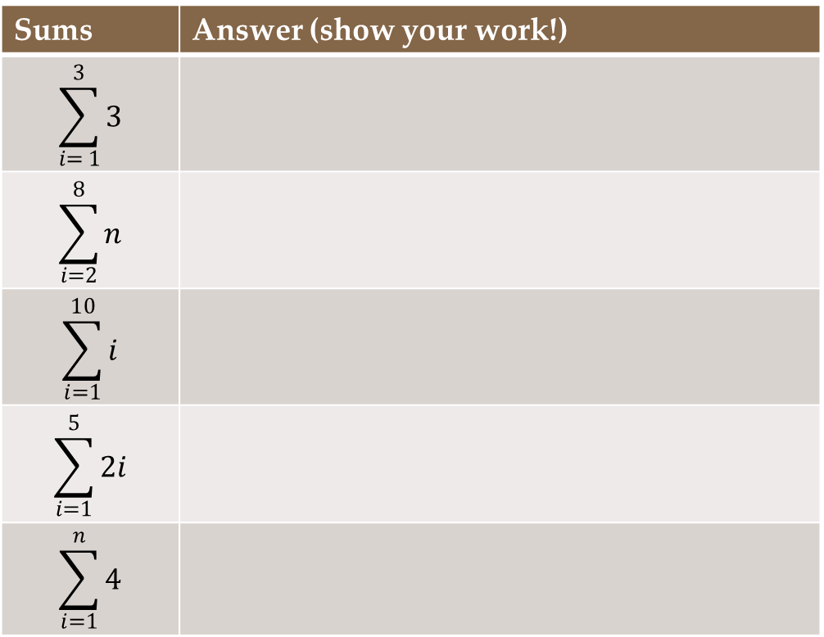
Try it!
Sums | Answer (show your work!)
$$\sum_{i= 1}^{3}{3}$$ | 3 + 3 + 3 = 9
$$\sum_{i=2}^{8}{n}$$ | n + n + … + n = 7n (8 – 2 + 1 terms)
$$\sum_{i=1}^{10}{i}$$ | 1 + 2 + 3 + 4 + 5 + 6 + 7 + 8 + 9 + 10 = 55
$$\sum_{i=1}^{5}{2i}$$ | 2*1 + 2*2 + 2*3 + 2*4 + 2*5 = 2 + 4 + 6 + 8 + 10 = 30
$$\sum_{i=1}^{n}{4}$$ | 4 + 4 + … + 4 = 4n (n terms)
Sums | Answer (show your work!)
$$\sum_{i= 1}^{3}{3}$$
$$\sum_{i=2}^{8}{n}$$
$$\sum_{i=1}^{10}{i}$$
$$\sum_{i=1}^{5}{2i}$$
$$\sum_{i=1}^{n}{4}$$

Slide 18
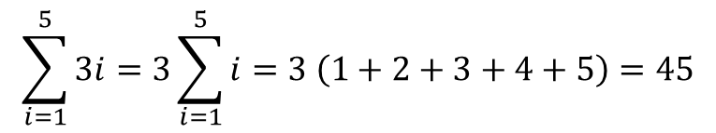
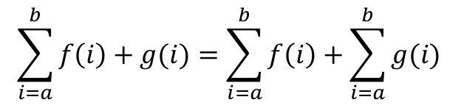
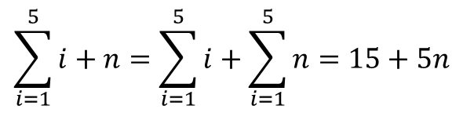
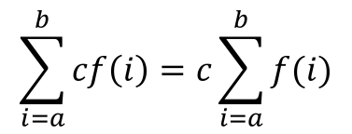
Summation rules
Pulling constants out of a sum
Summation of sums is the sum of summations
$$\sum_{i=a}^{b}{cf\left(i\right)=c\sum_{i=a}^{b}{f(i)}}$$
$$\sum_{i=1}^{5}{3i=3\sum_{i=1}^{5}{i}}=3 \left(1+2+3+4+5\right)=45$$
$$\sum_{i=a}^{b}{f\left(i\right)+g(i)=\sum_{i=a}^{b}{f\left(i\right)+\sum_{i=a}^{b}{g(i)} }}$$
$$\sum_{i=1}^{5}{i+n=\sum_{i=1}^{5}{i+\sum_{i=1}^{5}{n}}}=15+5n$$

Slide 19
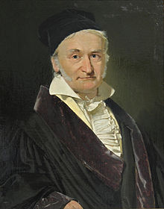
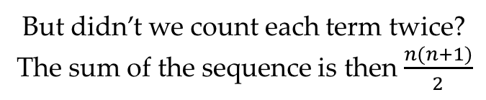
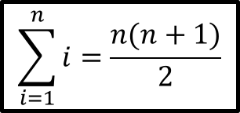
Summation identities
$$\sum_{i=1}^{n}{i}=\frac{n(n+1)}{2}$$
Terms of this
sequence
Gauss (circa 1800)
1 | 2 | 3 | 4 | … | n - 4 | n -3 | n -2 | n -1 | n
Terms in
reverse
order
+
n | n – 1 | n - 2 | n - 3 | … | 5 | 4 | 3 | 2 | 1
n + 1 | n + 1 | n +1 | n +1 | … | n + 1 | n + 1 | n + 1 | n + 1 | n + 1
Sum of the sequence is n(n + 1)
But didn’t we count each term twice?
The sum of the sequence is then $\frac{n(n+1)}{2}$

Slide 20

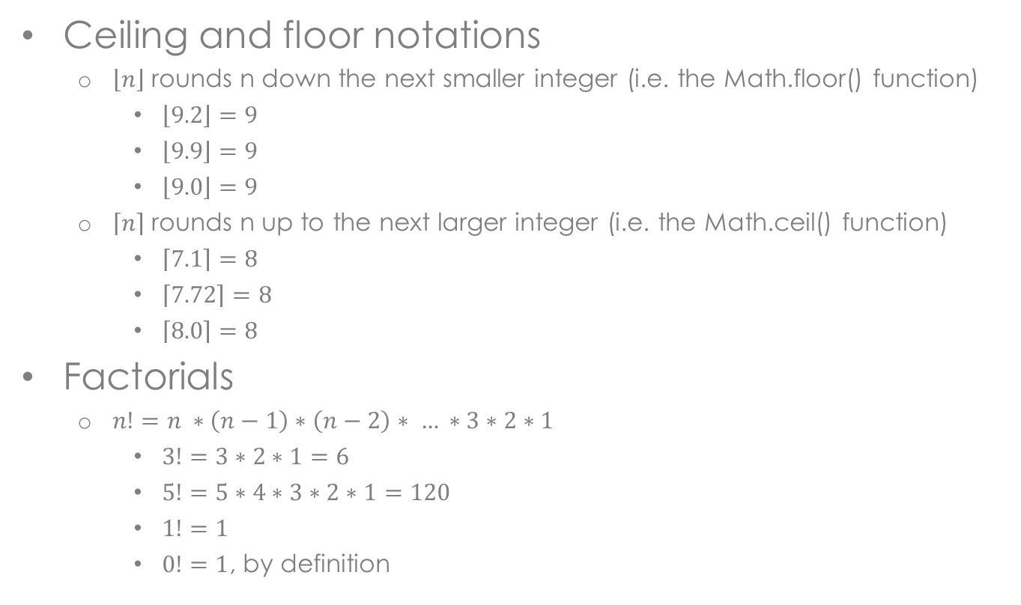
Other Math notations
Ceiling and floor notations
$\left\lfloor n\right\rfloor$ rounds n down the next smaller integer (i.e. the Math.floor() function)
$\left\lfloor 9.2\right\rfloor =9$
$\left\lfloor 9.9\right\rfloor =9$
$\left\lfloor 9.0\right\rfloor =9$
$\left\lceil n\right\rceil$ rounds n up to the next larger integer (i.e. the Math.ceil() function)
$\left\lceil 7.1\right\rceil =8$
$\left\lceil 7.72\right\rceil =8$
$\left\lceil 8.0\right\rceil =8$
Factorials
$n!=n ∗\left(n−1\right)∗\left(n−2\right)∗ … ∗3∗2∗1$
$3!=3∗2∗1=6$
$5!=5∗4∗3∗2∗1=120$
$1!=1$
$0!=1$, by definition

Slide 21
Computer Models
Big-oh, Runtime Analysis

Slide 22

Historical computer models
Computer models describe abstract computer architectures
Neumann model
Based on the descriptions of the mathematician Jon Von Neumann in 1945
Computers consist of six parts:
Processing unit
Arithmetic part (ALU)
Control part (controller)
Memory unit
Input
Output
Slow external memory
Coined the idea of a “stored program”

Slide 23
Neumann model
Bus
Processor (CPU)
Memory
Input-Output
Control Unit
Arithmetic Logic Unit
(ALU)
Stores data and
programs
Executes program
Communicates with
“outside world”, eg.
Screen
Keyboard
Storage Devices
…
Performs arithmetic
or logical operations

Slide 24
Algorithmic model
We will view our computer in a simplified manner
Goal: to measure algorithm efficiency independent of system specifications
Assumptions | Benefit
Each memory location is 32 bits | Ignore other word sizes (ie. 32 vs 64 bit architectures)
Assumptions | Benefit
Each memory location is 32 bits
Assumptions | Benefit
Each memory location is 32 bits | Ignore other word sizes (ie. 32 vs 64 bit architectures)
Assume we have infinite memory
Assumptions | Benefit
Each memory location is 32 bits | Ignore other word sizes (ie. 32 vs 64 bit architectures)
Assume we have infinite memory | Ignore hardware differences of machines
Assumptions | Benefit
Each memory location is 32 bits | Ignore other word sizes (ie. 32 vs 64 bit architectures)
Assume we have infinite memory | Ignore hardware differences of machines
Assume all arithmetic operations occur in a single atomic step (happen at the same speed)
Assumptions | Benefit
Each memory location is 32 bits | Ignore other word sizes (ie. 32 vs 64 bit architectures)
Assume we have infinite memory | Ignore hardware differences of machines
Assume all arithmetic operations occur in a single atomic step (happen at the same speed) | Ignore architecture details (ie. division is much, much slower than addition or subtraction)

Slide 25
Runtime Functions
Big-oh, Runtime Analysis

Slide 26
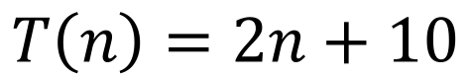
Measuring work done
A runtime function, T(n), is a function that models the work done in an algorithm
Function Input
Represents the size of an input given to an algorithm
$$T\left(n\right)=2n+10$$
Function Output
Represents the number of operations that will occur while the algorithm solves the problem

Slide 27
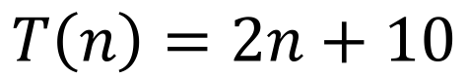
Measuring work done
$$T\left(n\right)=2n+10$$
Given an input of size n
our algorithm takes
2n + 10 steps to complete
Given an input size of 8 our algorithm takes 2*8 + 10 = 26 steps to complete

Slide 28
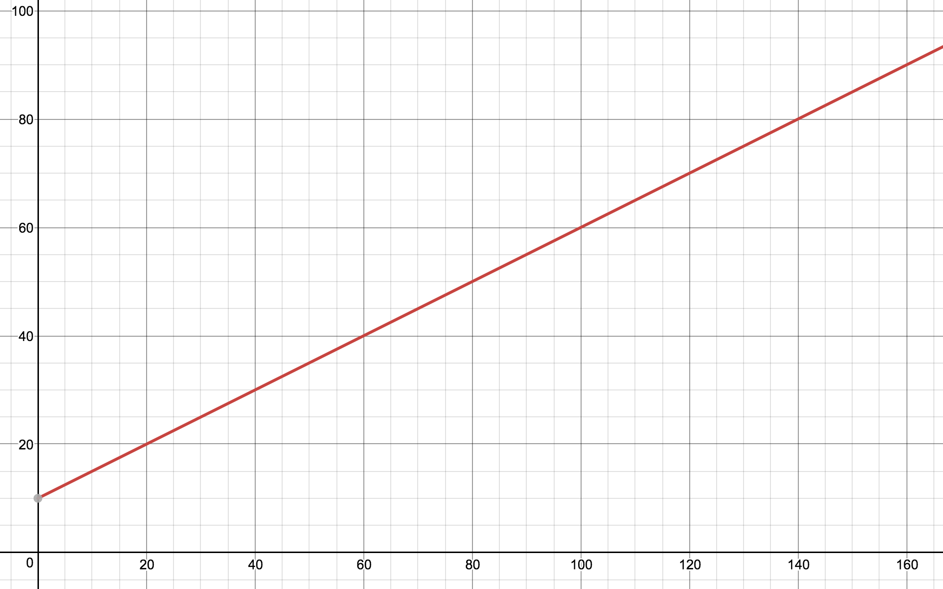
Graphing the work done
T(n) = 0.5n + 10
Work completed
Given an input
of size 60 our
algorithm will
take 40 operations
to complete
Input size

Slide 29
Graphing the work done
T(n) = 0.5n + 10
Work completed
A larger input
results in more
work that is
completed
Input size

Slide 30
Some thoughts
We can assume that for any algorithm we discuss in this class that a larger input means more work to complete
This happens because our runtime functions will all be monotonically increasing functions (well behaved)
Our goal: to discover efficient solutions to problems
How do we measure efficiency?
Model the work done through a runtime function
Keep the height of the function minimal for large inputs
What does the height represent?

Slide 31
The size of inputs
The size of inputs to an algorithm will typically determine the work that must be completed
i.e. a larger input will require more work
Types of inputs
Sometimes the input itself represents the size of a problem
public void countTo(int n)
Often the input is a data structure of a certain size
public void sort(String[] words)
Sometimes an algorithm will depend on the size of multiple inputs
public void compare(File first, File second)
“baby” | “apple” | “dinner” | “time” | “class” | “house” | “fortune” | “tired” | “await” | “silver”
0 | 1 | 2 | 3 | 4 | 5 | 6 | 7 | 8 | 9
length n

Slide 32
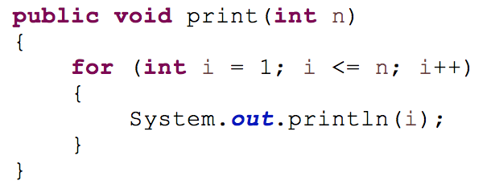
Calculating runtime functions
Let’s count the number of operations in this code segment
Cost model: a choice is made to only consider certain types of operations
Our cost model
Arithmetic operations: +, -, *, /, %
Logical operations: &&, ||, !
Comparison operations: <, <=, >, >=, ==, !=
Array accesses
Variable assignment

Slide 33
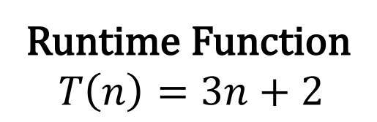
Calculating runtime functions
n + 1 comparisons
Why?
1 assignment
n additions
n assignments
Why?
Runtime Function
$$T\left(n\right)=3n+2$$

Slide 34
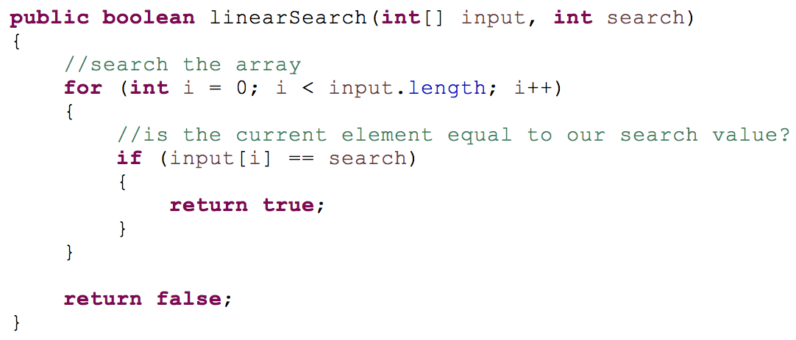
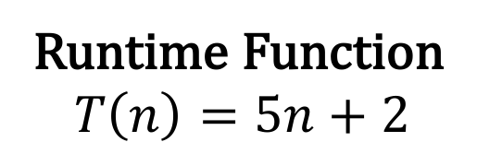
Linear search on an array of size n
2n additions,
assignments
1 assignment
n + 1 comparisons
Runtime Function
$$T\left(n\right)=5n+2$$
1, 2, 3, … , n comparisons &
array accesses?
In the worst case n comparisons

Slide 35
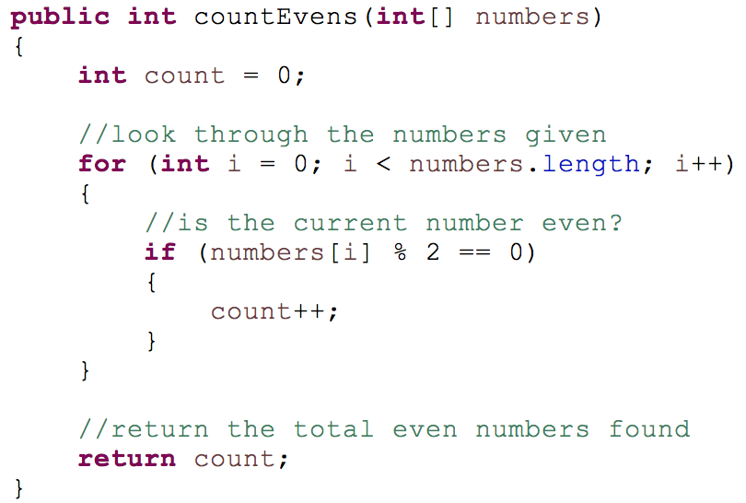
Using summations
Can we use summations to count the work done in the following code segment?

Slide 36
Using summations
How much work
is being completed
in a single iteration
of this loop?
2 comparisons
2 additions
2 assignments
1 array accesses
+ 1 mod operations
8 total operations
Note: there are still 2 assignments that happen before the loop begins
Note: there is a single comparison when the loop ends

Slide 37
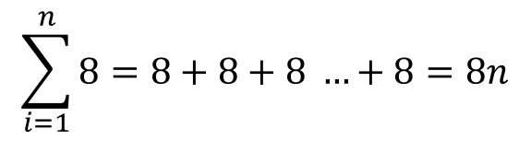
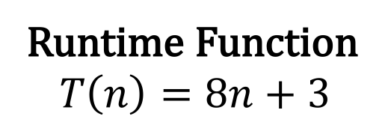
Using summations
This loop will
run n times.
This work can be
summarized with a
summation.
Work done in
each iteration
$$\sum_{i=1}^{n}{8}=8+8+8 …+8=8n$$
Runtime Function
$$T\left(n\right)=8n+3$$

Slide 38
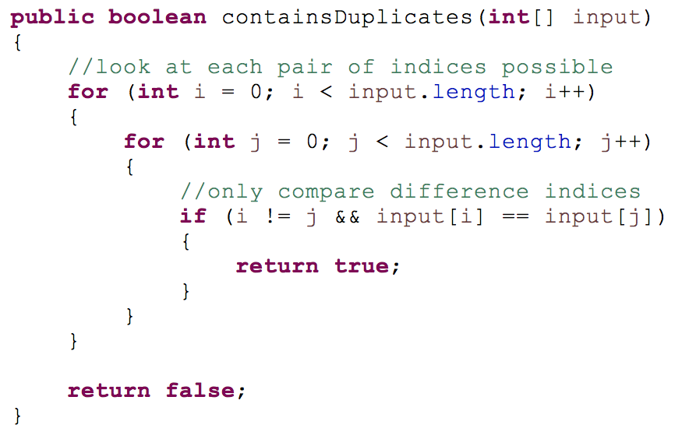
A more challenging example
How would you count the number of operations?

Slide 39
Simplifying our analysis
Observation
Most of the work
for this algorithm
will happen in the
innermost loop.

Slide 40
Simplifying our analysis
How much work
is done in the
innermost loop?
2 comparisons
1 logical operator
+ 2 array accesses
5 total operations

Slide 41
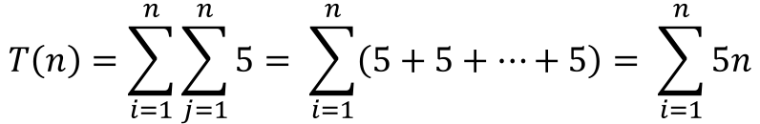
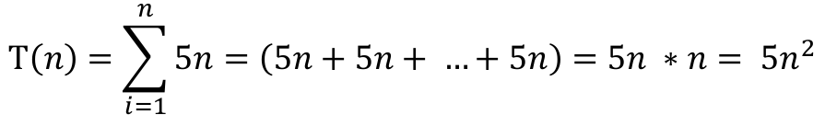
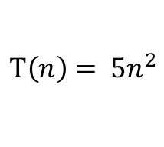
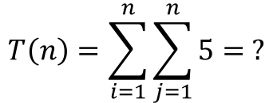
Using summations
We can use summations to count how many times the innermost loop is executed
$$T\left(n\right)=\sum_{i=1}^{n}{\sum_{j=1}^{n}{5= ?}}$$
$$T\left(n\right)=\sum_{i=1}^{n}{\sum_{j=1}^{n}{5= \sum_{i=1}^{n}{\left(5+5+…+5\right)= \sum_{i=1}^{n}{5n}}}}$$
$$T\left(n\right)=\sum_{i=1}^{n}{5n=\left(5n+5n+ …+5n\right)=5n ∗n= {5n}^{2}}$$
$$T\left(n\right)= {5n}^{2}$$

Slide 42
Orders of growth
Big-oh, Runtime Analysis

Slide 43
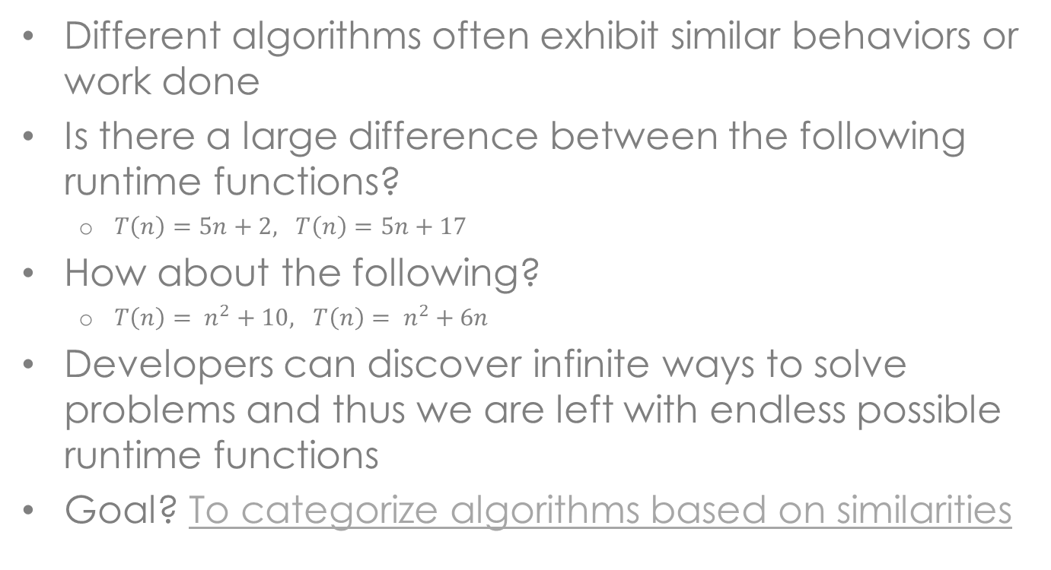
Orders of growth
Different algorithms often exhibit similar behaviors or work done
Is there a large difference between the following runtime functions?
$T\left(n\right)=5n+2, T\left(n\right)=5n+17$
How about the following?
$T\left(n\right)= n^{2}+10, T\left(n\right)= n^{2}+6n$
Developers can discover infinite ways to solve problems and thus we are left with endless possible runtime functions
Goal? To categorize algorithms based on similarities

Slide 44

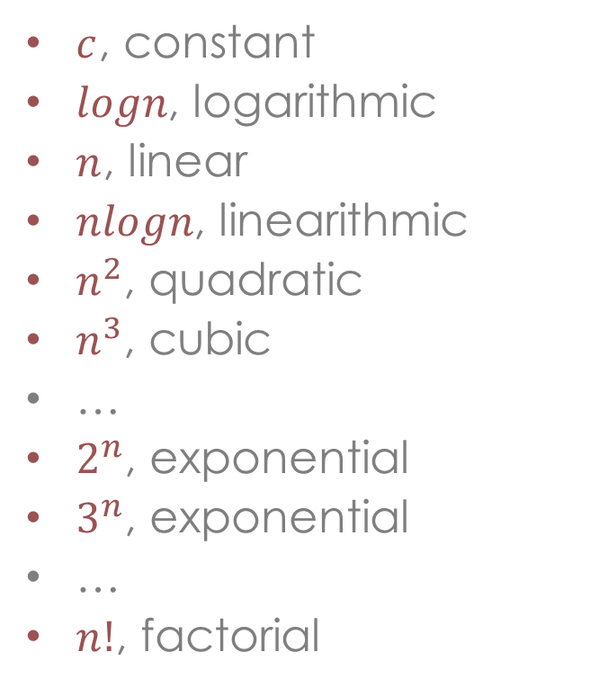
Orders of growth
$c$, constant
$logn$, logarithmic
$n$, linear
$nlogn$, linearithmic
$n^{2}$, quadratic
$n^{3}$, cubic
…
$2^{n}$, exponential
$3^{n}$, exponential
…
$n!$, factorial
Many algorithms can be modeled using a form of the following functions
How do these functions differ in terms of work done?

Slide 45
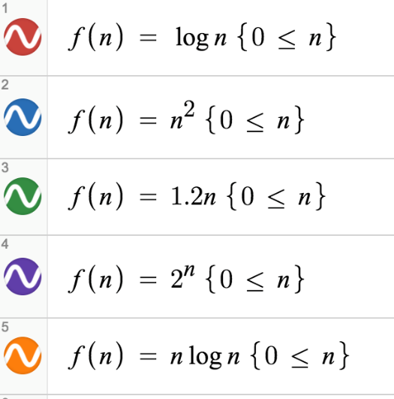
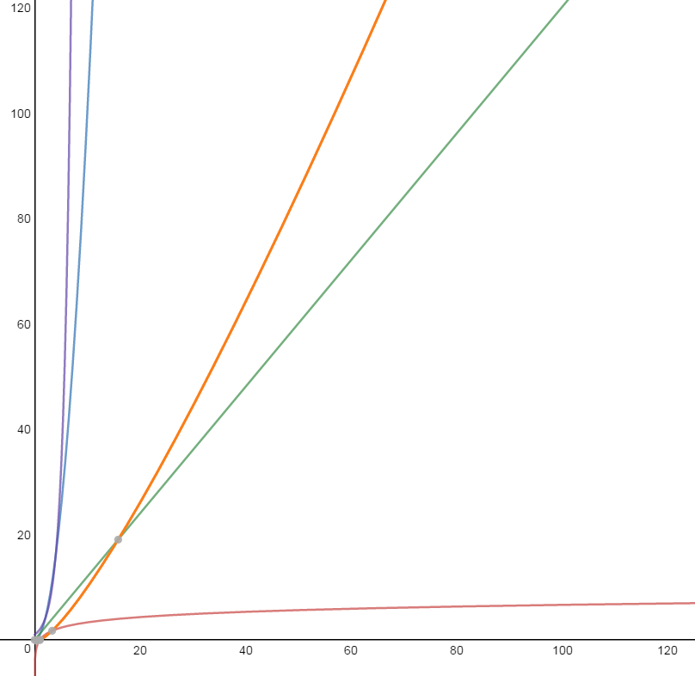
Orders of growth
The height of
a curve represents
the work we do
in an algorithm

Slide 46
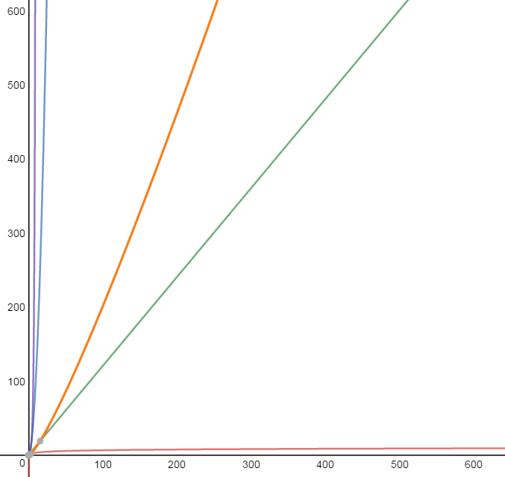
Orders of growth
The height of
a curve represents
the work we do
in an algorithm

Slide 47
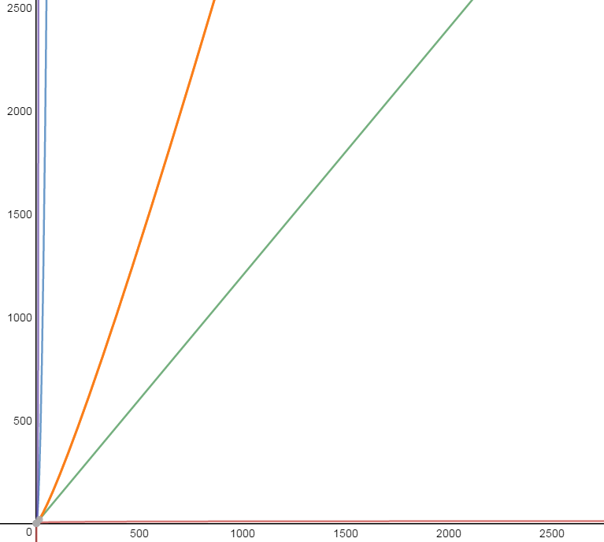
Orders of growth
The height of
a curve represents
the work we do
in an algorithm

Slide 48
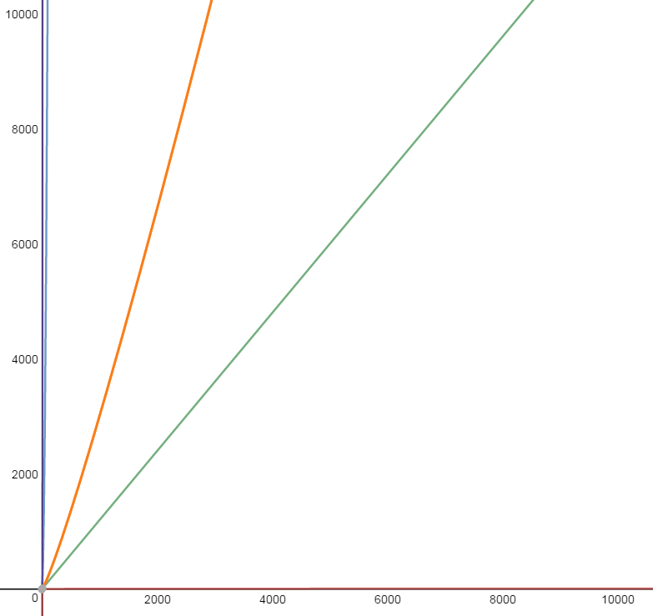
Orders of growth
The height of
a curve represents
the work we do
in an algorithm

Slide 49
Some observations
The difference between algorithms for small inputs is largely meaningless
We only care about work done on very large inputs
ie. sizes of 1,000,000+
Most of the order of growth functions differentiate themselves given these inputs
We are always pessimistic about work done for any input
We always assume we do the maximum possible work

Slide 50
Cut-off for efficiency
$c$, constant
$logn$, logarithmic
$n$, linear
$nlogn$, linearithmic
$n^{2}$, quadratic
$n^{3}$, cubic
…
$2^{n}$, exponential
$3^{n}$, exponential
…
$n!$, factorial
How do we deal with programs that fall below the cut-off?
Limit our input size (if possible)
Use another algorithm (if available)
Use approximation algorithm (with imperfect results)
efficient
inefficient

Slide 51
Big-oh notation
Big-oh, Runtime Analysis

Slide 52
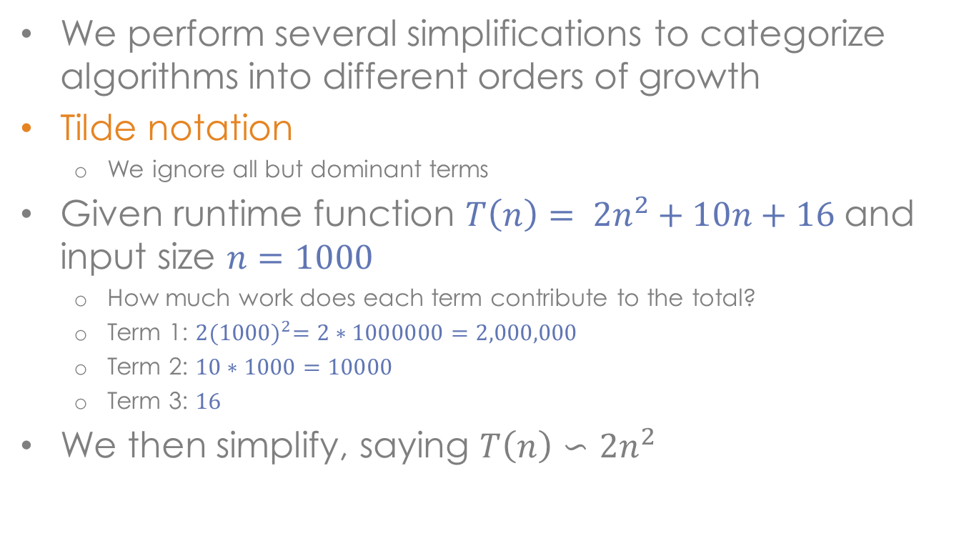
Tilde notation
We perform several simplifications to categorize algorithms into different orders of growth
Tilde notation
We ignore all but dominant terms
Given runtime function $T\left(n\right)= {2n}^{2}+10n+16$ and input size $n=1000$
How much work does each term contribute to the total?
Term 1: $2{(1000)}^{2}=2∗1000000=2,000,000$
Term 2: $10∗1000=10000$
Term 3: $16$
We then simplify, saying $T\left(n\right)∽{2n}^{2}$

Slide 53
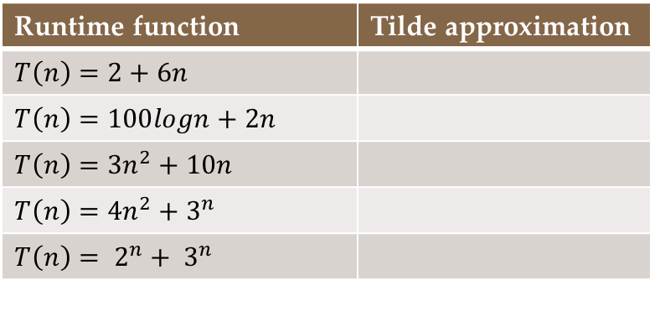
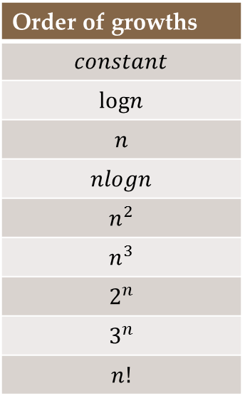
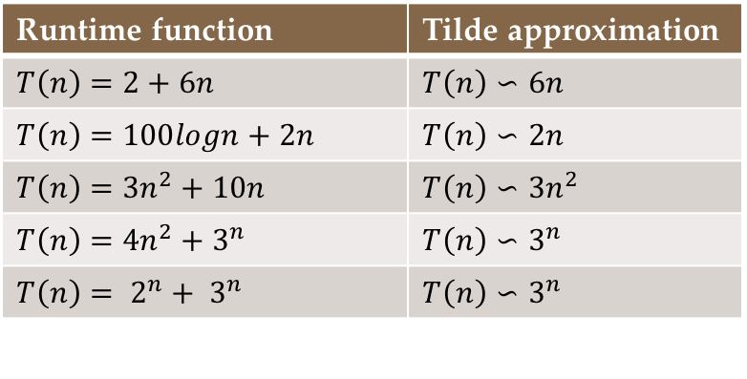
Tilde notation
Replace each of the following runtime function with a tilde approximation, by removing non-dominate terms
Determine
Order of growths
$$constant$$
$$logn$$
$$n$$
$$nlogn$$
$$n^{2}$$
$$n^{3}$$
$$2^{n}$$
$$3^{n}$$
$$n!$$
Runtime function | Tilde approximation
$$T\left(n\right)=2+6n$$ | $$T\left(n\right)∽6n$$
$$T\left(n\right)=100logn+2n$$ | $$T\left(n\right)∽2n$$
$$T\left(n\right)={3n}^{2}+10n$$ | $$T\left(n\right)∽3n^{2}$$
$$T\left(n\right)={4n}^{2}+3^{n}$$ | $$T\left(n\right)∽3^{n}$$
$$T\left(n\right)= 2^{n}+ 3^{n}$$ | $$T\left(n\right)∽3^{n}$$
Runtime function | Tilde approximation
$$T\left(n\right)=2+6n$$
$$T\left(n\right)=100logn+2n$$
$$T\left(n\right)={3n}^{2}+10n$$
$$T\left(n\right)={4n}^{2}+3^{n}$$
$$T\left(n\right)= 2^{n}+ 3^{n}$$

Slide 54
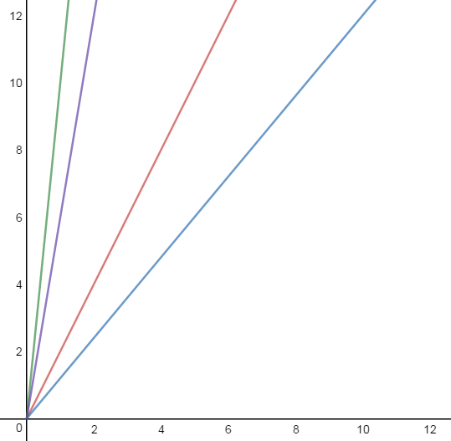
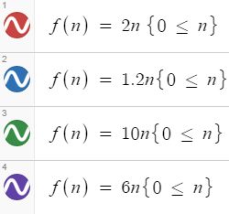
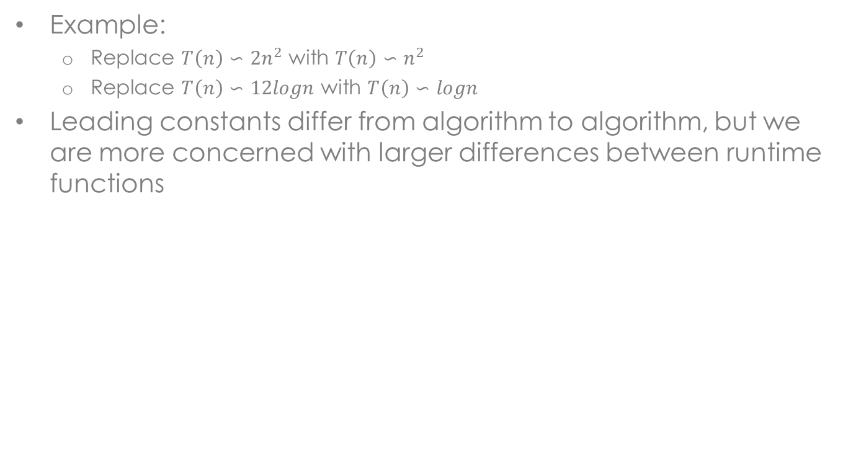
Ignore leading constants
Example:
Replace $T\left(n\right)∽{2n}^{2}$ with $T\left(n\right)∽n^{2}$
Replace $T\left(n\right)∽12logn$ with $T\left(n\right)∽logn$
Leading constants differ from algorithm to algorithm, but we are more concerned with larger differences between runtime functions
difference
meaningful

Slide 55


Ignore leading constants
difference
meaningful
difference
meaningful
difference
less
meaningful

Slide 56

Ignore leading constants
difference
meaningful
difference
meaningful
difference
less
meaningful

Slide 57

Ignoring the base of logs
You will often see the base of logs ignored with runtime analysis
We can essentially ignore the log of any base used in a runtime function as it only contributes to the leading constant of a function
Example: $T\left(n\right)=6\log_{4}\left(n\right)$
We normally would ignore the leading constant 6
Key observation: I can convert from one log base to any other log base and only incur a change to the leading constant
How?: The change of base formula!
$$T\left(n\right)=6\log_{4}\left(n\right)=6∗\frac{\log_{2}\left(n\right)}{\log_{2}\left(4\right)}=6∗\frac{1}{2}∗\log_{2}\left(n\right)=3\log_{2}(n)$$
Only differ by a constant, which we ignore!

Slide 58

Big-oh notation
A notation for measure the asymptotic behavior of functions
Useful for denoting the difference in speed between algorithms for very large inputs
Notations:
Notation | General form | Example
Big-oh | $$f\left(n\right)=O(g\left(n\right))$$ | $$f\left(n\right)=O(n^{2})$$
Big-omega | $$f\left(n\right)= Ω(g\left(n\right))$$ | $$f\left(n\right)= Ω(logn)$$
Big-theta | $$f\left(n\right)= Θ(g\left(n\right))$$ | $$f\left(n\right)= Θ(n)$$
Little-oh | $$f\left(n\right)=o(g\left(n\right))$$ | $$f\left(n\right)=o(nlogn)$$
Little-omega | $$f\left(n\right)= ω(g\left(n\right))$$ | $$f\left(n\right)=ω(n!)$$

Slide 59



Big-oh
Formal definition: We say that f(n) is O(g(n)) if there are positive integers c and k such that $f\left(n\right)≤c∗g(n)$, for all $n>k$.
Colloquial definition: Given a large enough input n, g(n) is an upper bound for f(n)
$$c∗g(n)$$
$$f(n)$$
k

Slide 60

Big-oh
Another less precise definition: We are trying to say that $f\left(n\right)≤g(n)$ for large values of n and within a constant factor.
$$c∗g(n)$$
$$f(n)$$
K

Slide 61


How do we use big-oh
Given an algorithm
Print the first n positive integers
and a runtime function
$T\left(n\right)=3n+2$
We can simplify our runtime function
Only consider dominate terms: $T\left(n\right)∽3n$
Ignore leading constants: $T\left(n\right)∽n$
and compare it against a well-known growth rate
$T\left(n\right)=O(n)$
Note: This last statement says that given large
inputs, the work represented by our runtime
function T(n) will be less than or equal to
the function $g\left(n\right)=n$ (within a constant factor).

Slide 62


What does that mean?
We are making a relative argument about the speed of our algorithm.
Consider the following scenario:
What is Wally claiming by asserting that $T\left(n\right)=O(nlogn)$?
Wally is a developer for Microsoft. He has been using
a well-known fast algorithm for sorting arrays defined
in the Arrays.sort() method. Wally decides to design a
new sorting algorithm to improve the runtime of his
program. After some analysis he calculates that his new
routine has a runtime of $T\left(n\right)=6nlogn+n$. Wally is
also aware that the growth rate of the algorithm in
Arrays.sort() is nlogn. Therefore Wally concludes that
$T\left(n\right)=O(nlogn)$. Wally seems pretty pleased with
himself, but he is aware that there might be room for
improvement.

Slide 63



Relative speed
If we claim $T\left(n\right)=O\left(nlogn\right)$
We are saying that our algorithm does less work or equal work than $nlogn$ operations (within a constant factor)
Key concept: By showing that our algorithm is “no worse” than another fast algorithm, we are in fact arguing that our algorithm “is fast”
Order of growths
$$constant$$
$$logn$$
$$n$$
$$nlogn$$
$$n^{2}$$
$$n^{3}$$
$$2^{n}$$
$$3^{n}$$
$$n!$$
Cutoff

Slide 64


Try it
Given the following runtime functions T(n), give a big-oh estimate
Runtime function | Big-oh estimate
$$T\left(n\right)=6logn+3n$$
$$T\left(n\right)=18$$
$$T\left(n\right)=14n^{2}+2n+1$$
$$T\left(n\right)=nlogn+40n$$
$$T\left(n\right)=3nlogn$$
Runtime function | Big-oh estimate
$$T\left(n\right)=6logn+3n$$ | $$O(n)$$
$$T\left(n\right)=18$$ | $$O(1)$$
$$T\left(n\right)=14n^{2}+2n+1$$ | $$O(n^{2})$$
$$T\left(n\right)=nlogn+40n$$ | $$O(nlogn)$$
$$T\left(n\right)=3nlogn$$ | $$O(nlogn)$$
Note: Any constant runtimes are denoted in big-oh as $O(1)$.

Slide 65

Tight bounds
We want to claim a tight upper bound for our algorithm
Consider an analysis of countEvens()
$T\left(n\right)=8n+2$
$T\left(n\right)∽n$
$T\left(n\right)=O(n)$
Note: we can also say the following (why?)
$T\left(n\right)=O\left(nlogn\right)$
$T\left(n\right)=O\left(n^{2}\right)$

Slide 66




Tight bounds
For large enough inputs n, the functions $n^{2}$ and $nlogn$ are upper bounds
f(n) = n is bounded from
above by $n^{2}$ and $nlogn$ for all
n greater than some
constant K
Is it useful to state
these other upper
bounds?
K

Slide 67



Big-omega
Formal definition: We say that f(n) is $Ω$(g(n)) if there are positive integers c and k such that $f\left(n\right)≥c∗g(n)$, for all $n>k$.
Colloquial definition: Given a large enough input n, g(n) is an lower bound for g(n)
$$f(n)$$
$$c∗g(n)$$
K

Slide 68

Big-omega
Another less precise definition: We are trying to say that $f\left(n\right)≥g(n)$ for large values of n and within a constant factor.
Meaning: f(n) will always be at least as slow as g(n) (within a constant factor)
$$f(n)$$
$$c∗g(n)$$
K

Slide 69


Big-theta
Formal definition: We say that f(n) is $Θ$(g(n)) iff (if and only if) $f\left(n\right)=O\left(g\left(n\right)\right) and f\left(n\right)=Ω(g\left(n\right))$
The first implies $f\left(n\right)≤g\left(n\right)$
The second implies $f\left(n\right)≥g\left(n\right)$
Together these imply $f\left(n\right)=g\left(n\right)$, within a constant factor
Meaning: f(n) and g(n) are in the same growth category and differ by a constant factor
$$g(n)$$
Differ by
a constant
$$f(n)$$
K

Slide 70


Imprecise shorthand
The notations for big-oh, omega and theta can be visualized using the standard comparison operators
Assume the following holds for large n (within a constant factor):
f(n) = O(g(n)) ➔ f(n) <= g(n)
f(n) = $Ω$(g(n)) ➔ f(n) >= g(n)
f(n) = $Θ$(g(n)) ➔ f(n) == g(n)

Slide 71

Practice
Given the following functions, determine which of the following relationships are true:
$f\left(n\right)=2n+16$
$g\left(n\right)=n^{2}+3n$
Relationships
$g\left(n\right)=O\left(n\right)$
False, $n^{2}$ is a dominant term and is not bounded above by any linear function for large n
$f\left(n\right)=O\left(n^{2}\right)$
True, $f\left(n\right)=O\left(n\right)$, so it must also be $O(n^{2})$
$f\left(n\right)=Θ\left(n\right)$
True, the dominant term in f(n) differs from n by a constant
$g\left(n\right)=O\left(n^{3}\right)$
True, $g\left(n\right)=Θ(n^{2})$, so it must also be $O(n^{3})$
$g\left(n\right)= Ω\left(n\right)$
True, the leading term $n^{2}$ is greater than $n$ for all large inputs

Slide 72


Other notations
Little-oh and little-omega represent the remaining two comparison relationships
Little-oh:
Denoted $f\left(n\right)=o\left(g\left(n\right)\right)$
Represents a strict upper bound (i.e. $f\left(n\right)<g(n)$ for large n)
Little-omega:
Denoted $f\left(n\right)=ω\left(g\left(n\right)\right)$
Represents a strict lower bound (i.e. $f\left(n\right)>g(n)$ for large n)

Slide 73

Counting loops
Do we really need to count individual steps for a runtime function when we throw out constants?
Alternatively we can count loops:
This loop will run
n times, since we
don’t consider
constants we can
quickly conclude
this function is O(n)

Slide 74


Counting loops
How would we count loops for this code segment?
The outer loop
runs n times
The inner loop
runs n times
Ignoring constants,
the innermost loop
will run $n∗n$ times. So we conclude that this function is $O(n^{2})$.

Slide 75



Counting loops
Is the following function $O(n^{2})$?
You must be careful
with this type of
short-hand analysis.
The inner loop runs
a constant number of
times. So this function
is actually $O(n)$.

Slide 76

Last thoughts
Sometimes you can make observations concerning an algorithm that allow you generalize about the work done
What does the structure of my data look like?
How is the data organized?
How does this reduce the work my algorithm completes?
This will be the case when discussing
Binary search trees
Heaps
Binary search
…
A rigorous analysis requires mathematics to support any big-oh claims

Slide 77
Data Structures & Algorithm Analysis
Big-OH, Runtime Analysis

